Slide 1

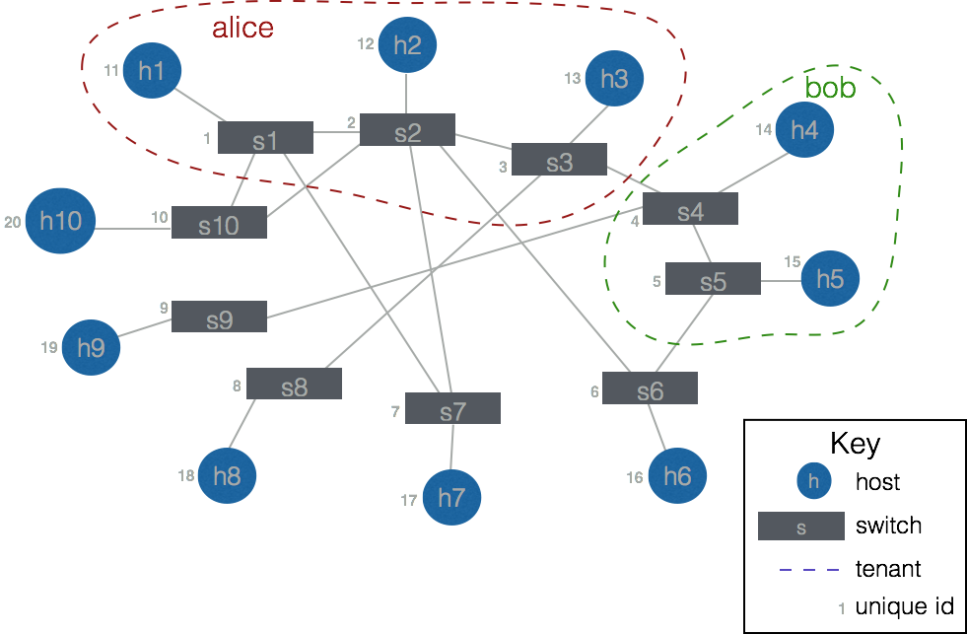
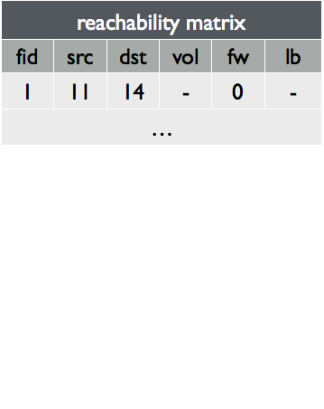
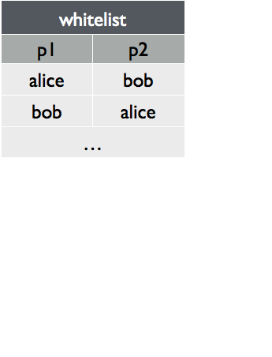
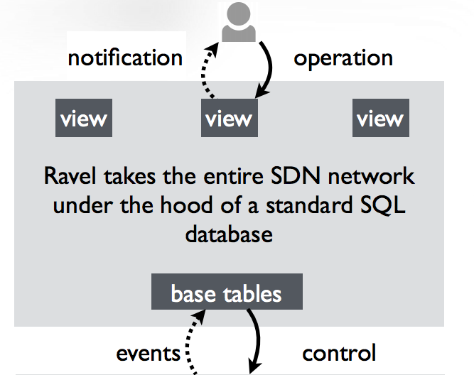
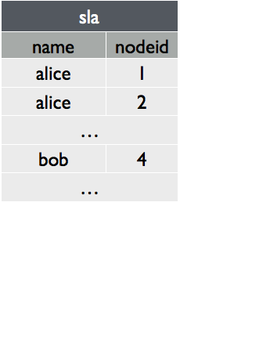
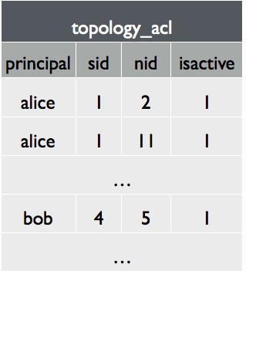
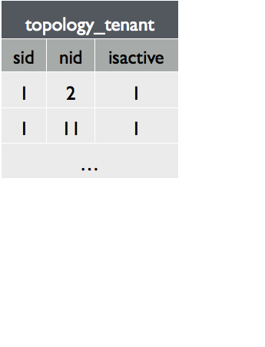
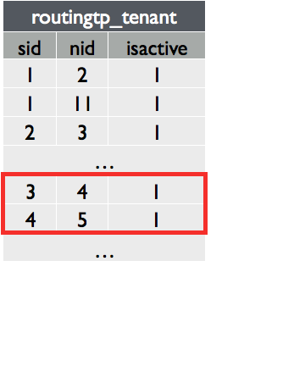
Access Control for a Database-Defined Network
Temple University REU 2016
Noemi Glaeser, University of South Carolina
Mentor: Anduo Wang, Temple University
Introduction
Access Control for Network Updates
Software-defined networking (SDN): insertion of software to manage network with centralized controller
Ravel: database-defined controller, like many others currently exposes network states to users
More efforts needed to improve SDN security
This project adds access control application to Ravel
Add flow
trigger
check whitelist for compliance
Database-Defined Network
Working example of a network with two tenants
SDN: control distributed set of devices with a centralized controller
Ravel is the realization of SDN by database
SQL interface
Views: user-defined abstractions for individual applications
Orchestration: coordinate updates between multiple applications
Security
Ravel does not yet have security implemented
This project adds access control, a specific aspect of security
Access Control for Network Resources
Challenge: Controlling Network Updates
Service-level agreement (SLA)
Goal: Select a path through only nodes compliant with a user’s SLA.
Create routingtp_tenant view to achieve this goal
Calculate a path that contains only nodes listed in this view
whitelist
network
user = alice
SQL query
SQL query
topology table
user = alice
CREATE OR REPLACE VIEW topology_tenant AS (
SELECT sid, nid, isactive FROM topology_acl
WHERE principal = current_user);
Ravel: ravel-net.org
Demo: github.com/ravel-net/REU-access-control

